Slide 1


HomeSync - IoT Based Home Automation System

Slide 2

CONTENTS
1. Introduction
2. Features
3. Prerequisites

Slide 3

1. Introduction
A modern, intelligent smart home automation application built with Next.js, TypeScript, and Tailwind CSS. Control your IoT devices, manage routines, monitor energy usage, and receive AI-powered suggestions for optimal home automation. AI ML concept is used in making the project

Slide 4
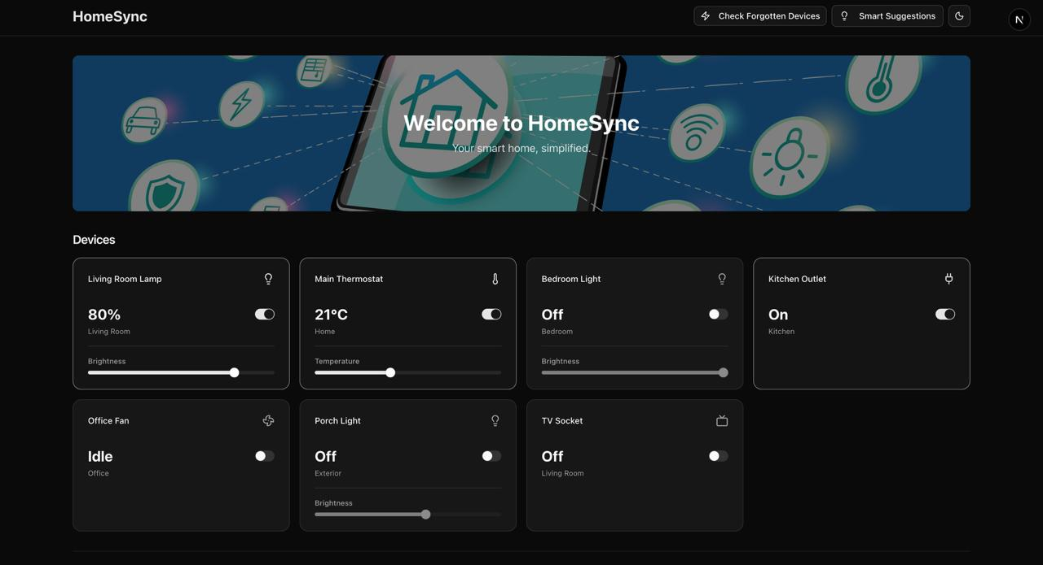
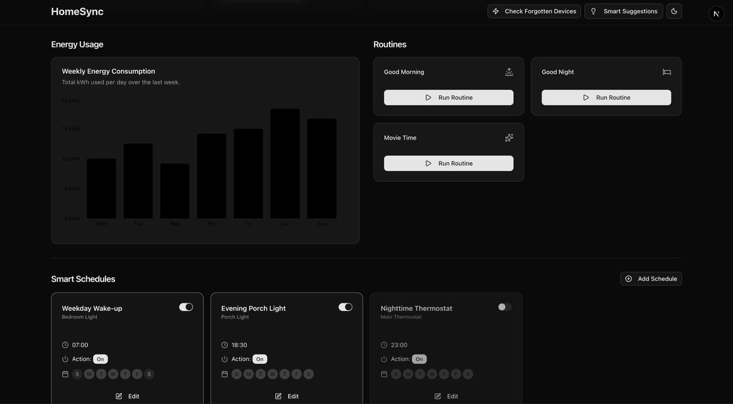
USER INTERFACE

Slide 5
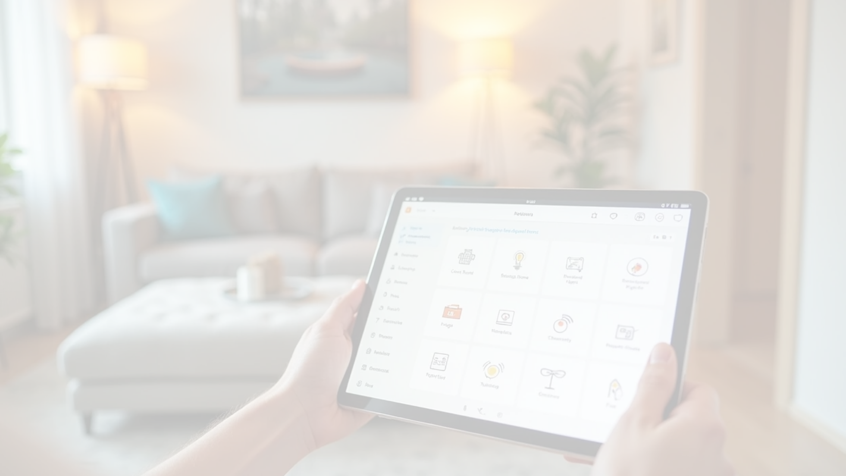





2. Features
Core Functionality
Device Control
Smart Routines
Energy Monitoring
Toggle lights, thermostats, fans, and outlets with intuitive controls.
Pre-configured automation routines (Good Morning, Good Night, Movie Time).
Real-time energy usage tracking with AI-powered alerts.
Smart Schedules
AI-Powered Suggestions
Forgotten Appliance Detection
Automated device control based on time and day schedules.
Intelligent routine recommendations based on usage patterns.
AI detects and alerts about devices left running.

Slide 6
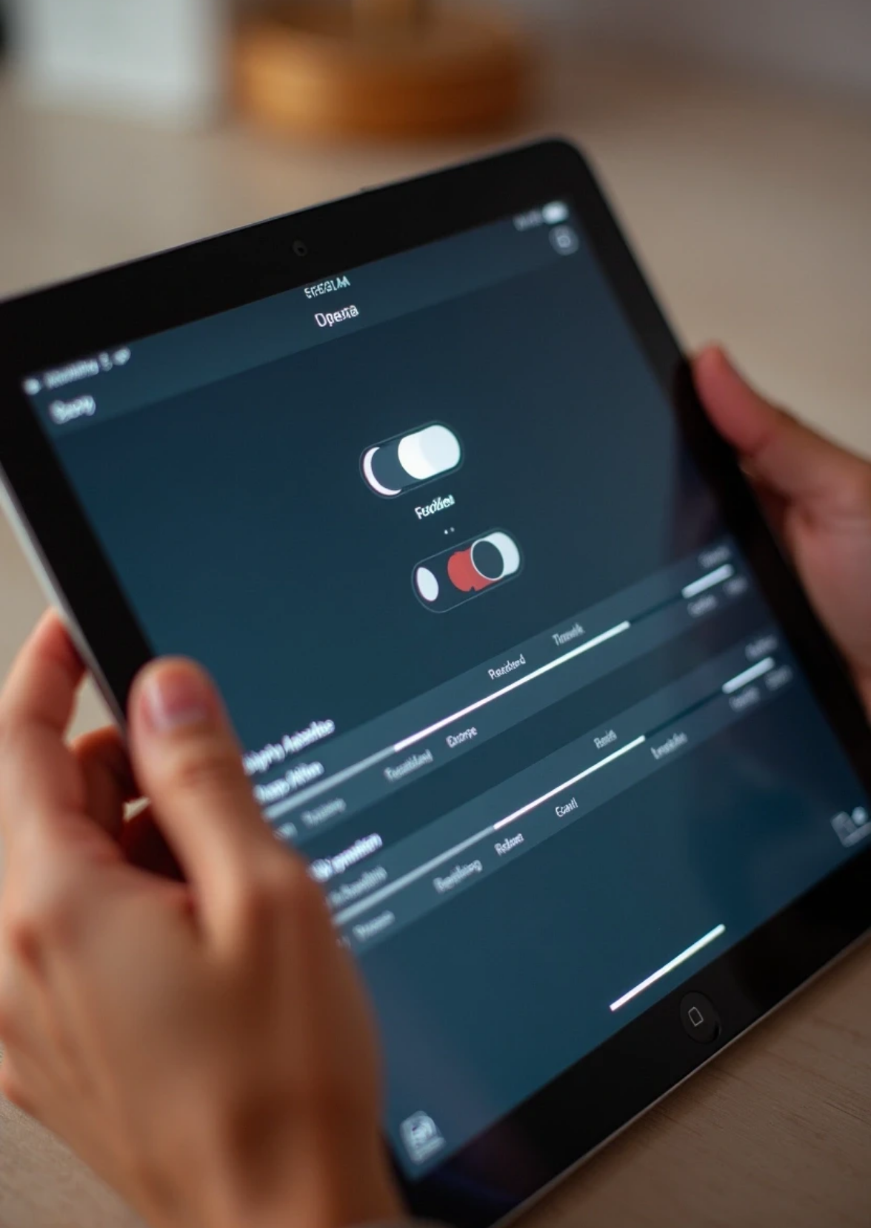









User Experience
1
2
Dark/Light Theme Toggle
Responsive Design
Optimized for desktop, tablet, and mobile devices.
Seamless theme switching with system preference support.
3
4
Real-time Updates
Toast Notifications
Instant feedback on device status changes.
User-friendly alerts and confirmations.

Slide 7



Technical Features
TypeScript
Server Actions
Full type safety throughout the application.
Secure server-side processing for AI flows.
Component Architecture
Accessibility
WCAG compliant UI components.
Modular, reusable React components.

Slide 8












Tech Stack
1
2
3
Frontend
Styling
Icons
Next.js 15, React 18, TypeScript.
Tailwind CSS, Radix UI components.
Lucide React.
4
5
6
Charts
Forms
AI Integration
Recharts.
React Hook Form with Zod validation.
Custom AI flows for device control and suggestions.
7
Backend Ready
Appwrite integration for database and authentication.

Slide 9




3. Prerequisites
Node.js 18+
npm, yarn, pnpm, or bun
Appwrite account (for database functionality).

Slide 10

Thank You

